Slide 1
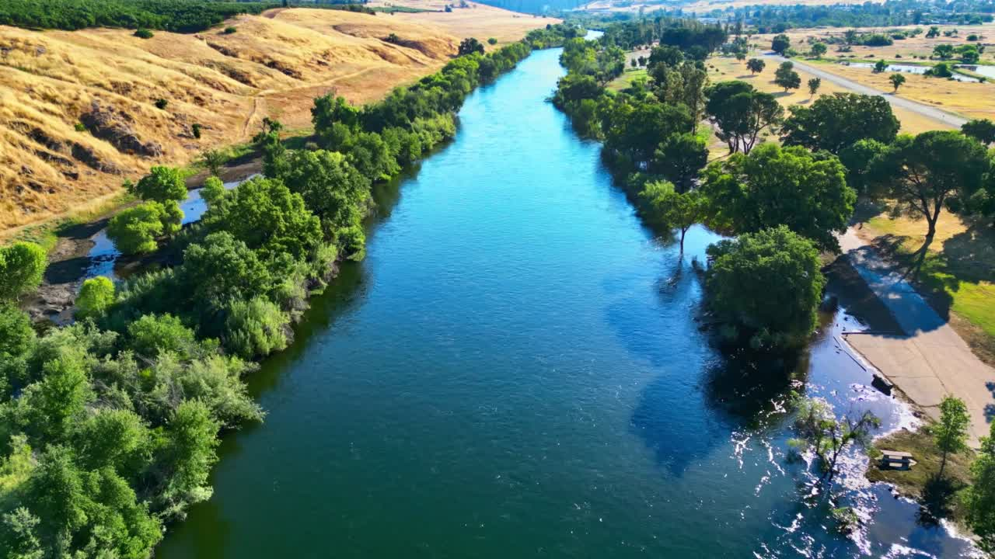


WATER CONSERVATION :
CONTAMINATED RIVER WATER PARAMETERS
BY LEBOGANG LETSOALO

Slide 2
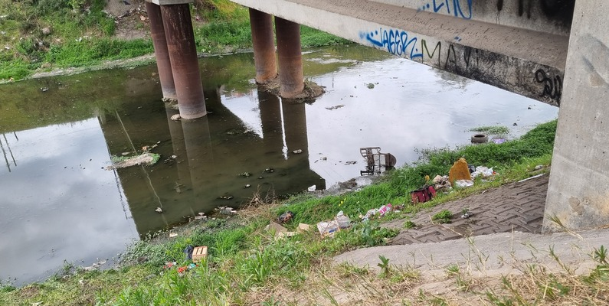
Introduction
The goal is to predict the DO parameter of
the river based on the other features

Slide 3



DATA COLLECTION

Slide 4

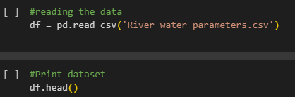
LOADING DATA

Slide 5

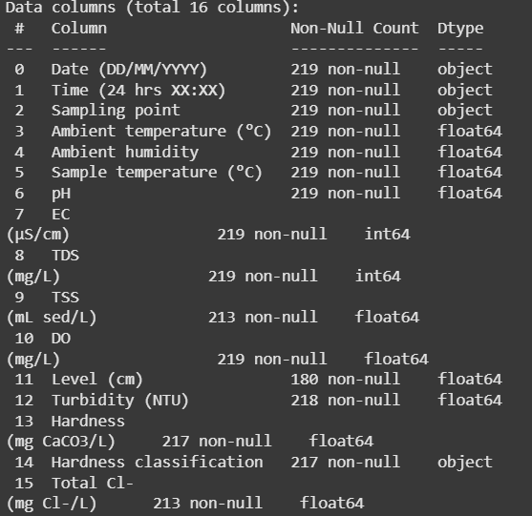
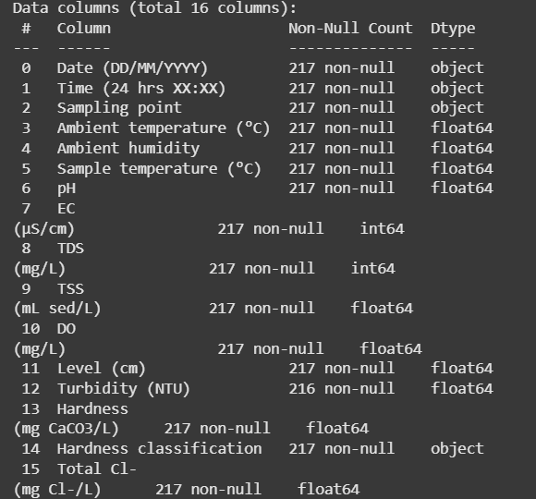

DATA CLEANING
Before
After

Slide 6

Exploratory
Data
Analysis
The use statistics and visualizations to explore the data

Slide 7
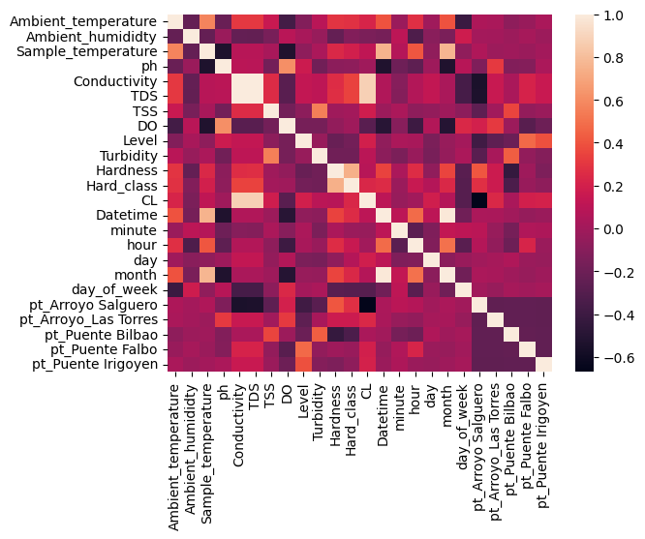
Heatmap

Slide 8
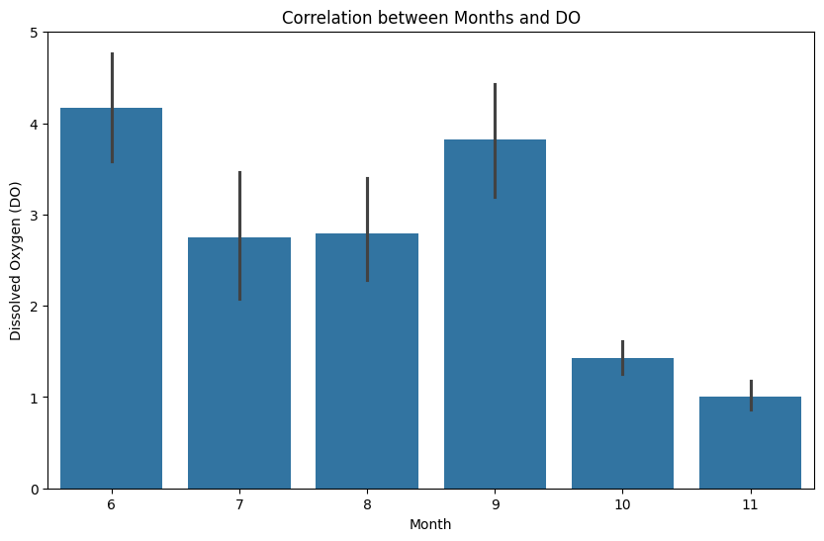

Slide 9
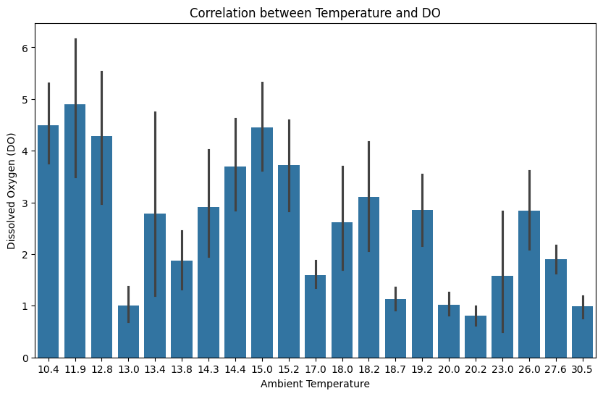

Slide 10
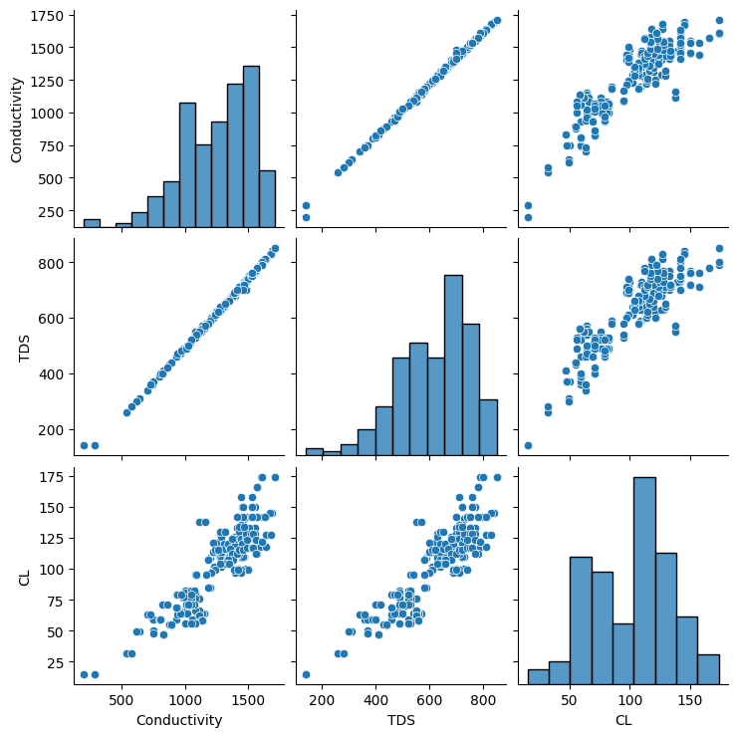

Slide 11

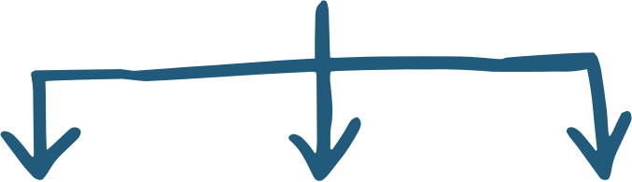
Modelling
Linear Regression
RMSE: 1.070
XG Boost
SVD RMSE: 1.1400
SVD RMSE: 1.1400
XGBRegressor
RMSE: 1.1274

Slide 12

Conclusion
In conclusion we see the impact of the different factors on dissolved oxygen is roughly linear.
And for us to to be able to counteract the effects of all the other factors from dropping DO we can have separate solutions such as:
High TDS (Total Dissolved Solids): Use filtration or dilution methods to lower mineral and contaminant concentrations.
y.
Ambient temperature, Ambient humidity, Sample temperature (°C)

Slide 13

Thank You
For Your Attention
By Lebogang Letsoalo

